Slide 1
NestReady buyer pipeline
Ricardo Sarto (Backend Developer)
Maria Carolina de Souza Santos (UX Designer)
Marina Crachi (Frontend Developer)
William Pispico Ferreira (Devops)

Slide 2



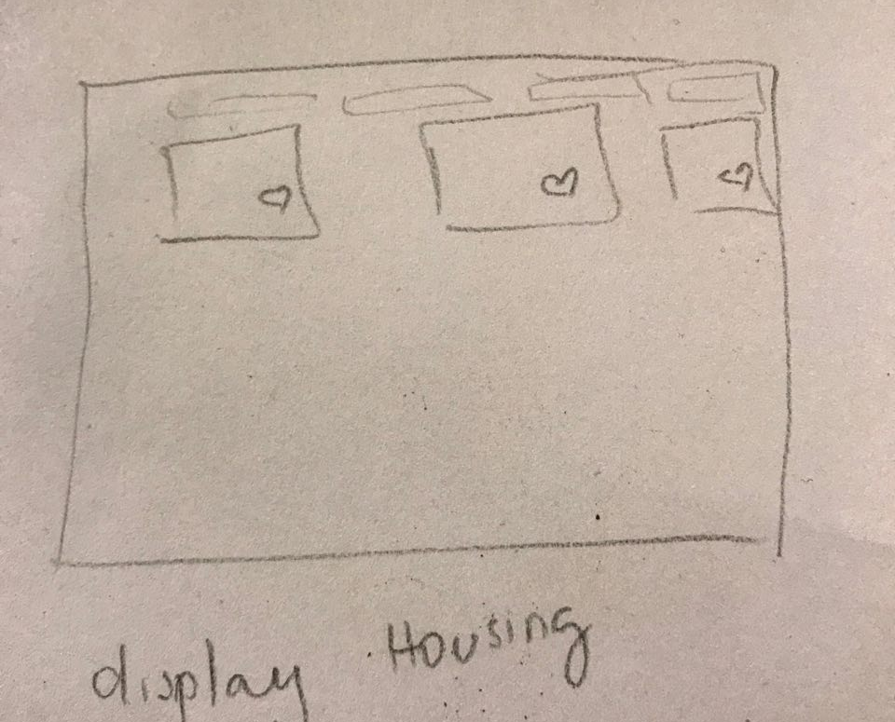
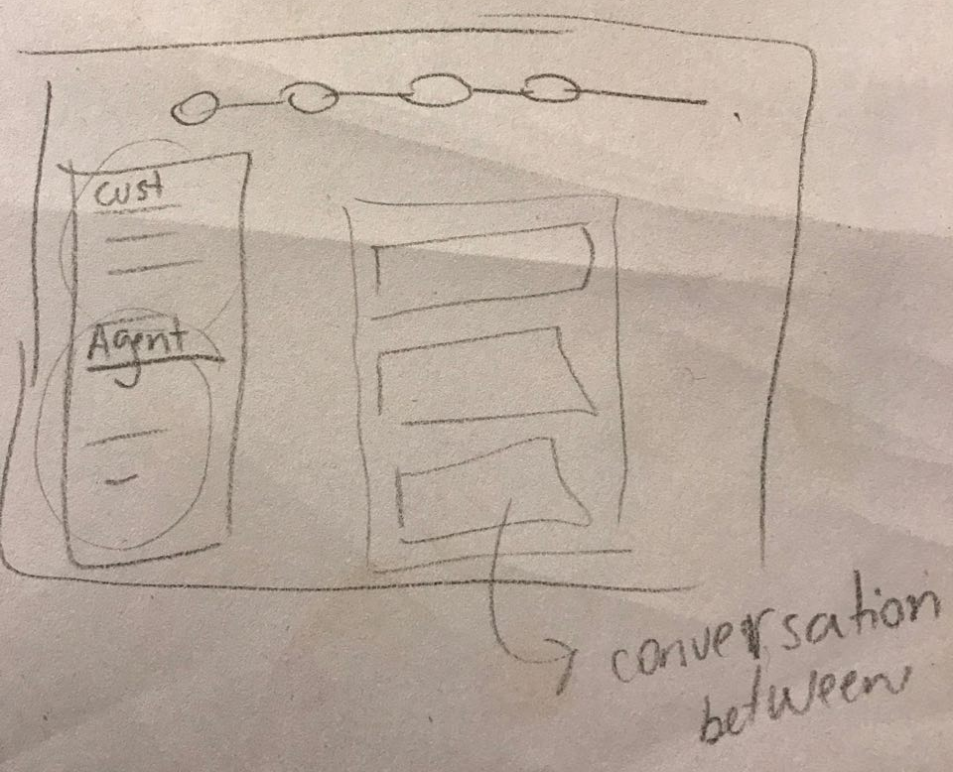
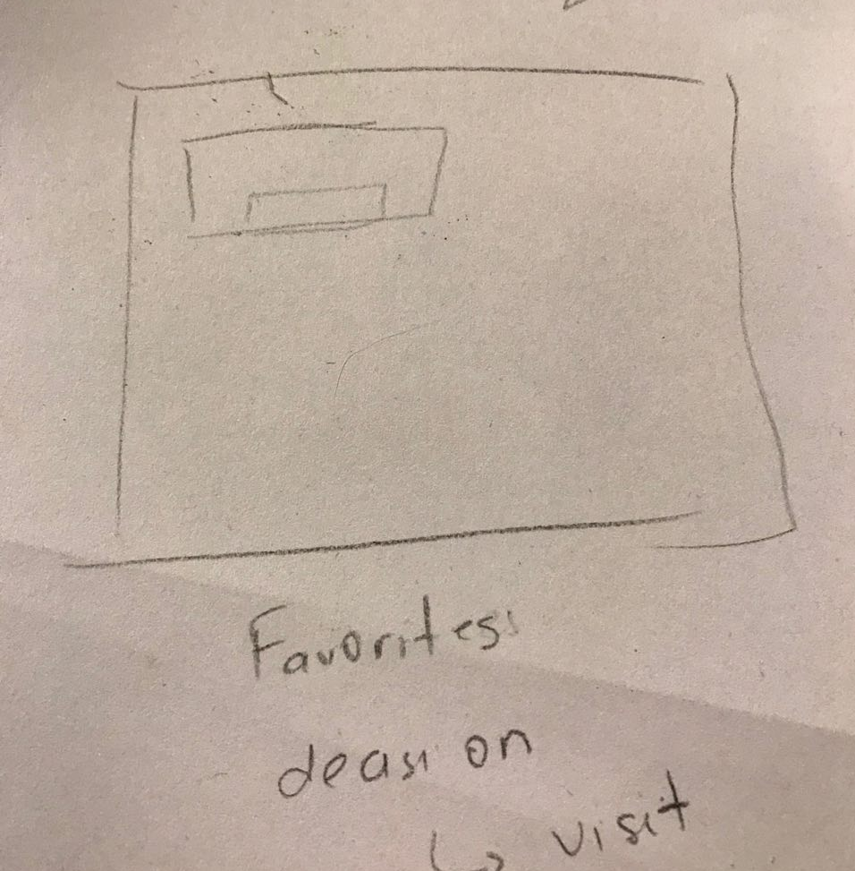
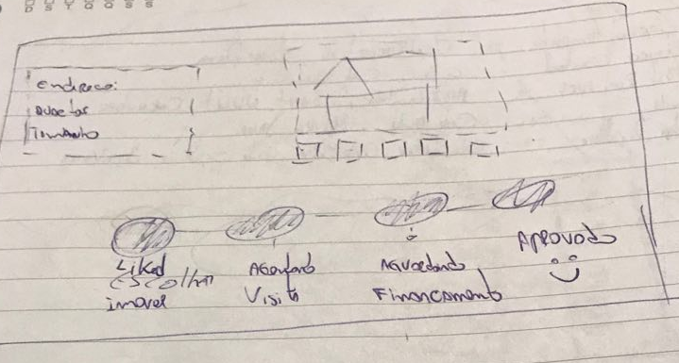
Empathize and Define phase
Design process
Ideate phase
First, we created a low-fidelity prototype and we defined the user flow.
We care about user journey to find a place to live and take ownership of the process.
After a brainstorm, we proposed a way to user understand and follow up the scheduling visit and mortgage process mortgage process.

Slide 3
Prototyping
Design process
We created interactive prototype using Figma, Photoshop and Illustrator.
Feel free to visit our interactive prototype:
https://www.figma.com/proto/OdGq8vRG8TZfgVRCkCjeQciY/Untitled?node-id=9%3A2690&viewport=261%2C260%2C0.0864703&scaling=contain

Slide 4
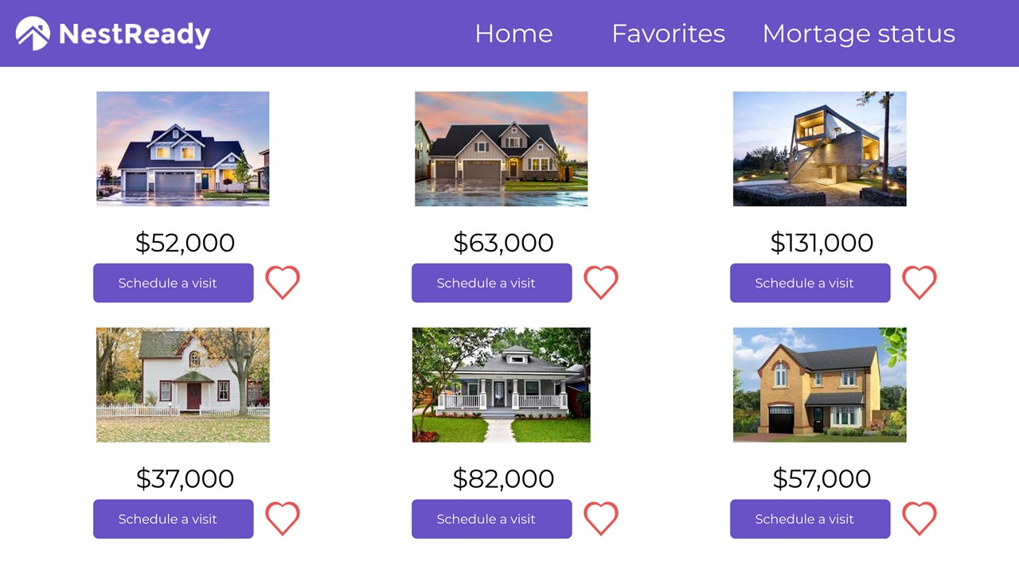
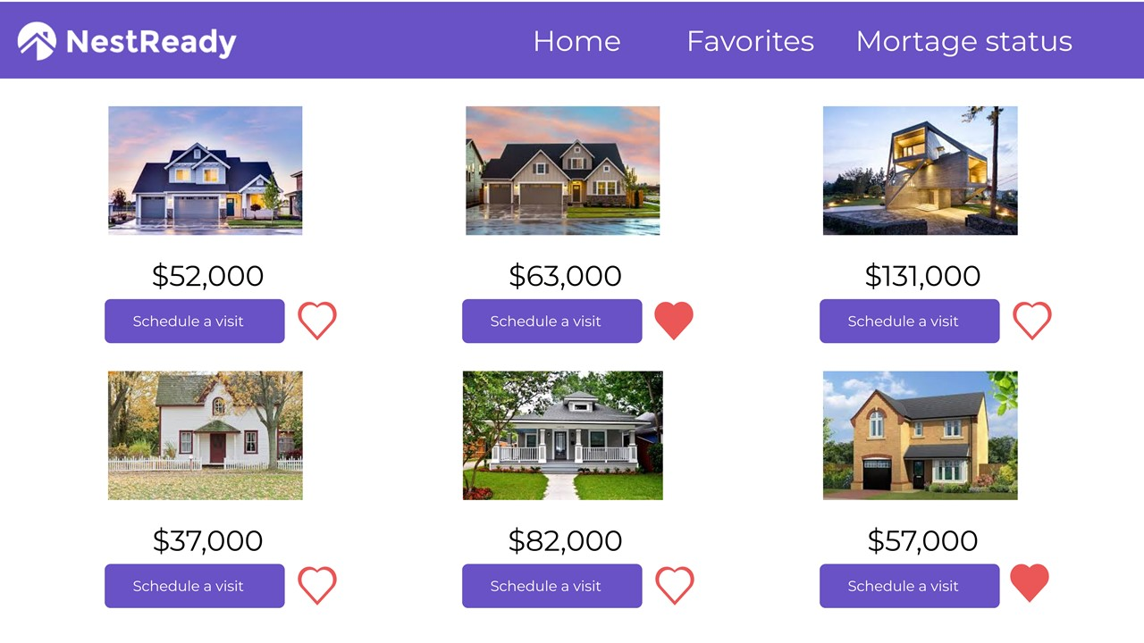
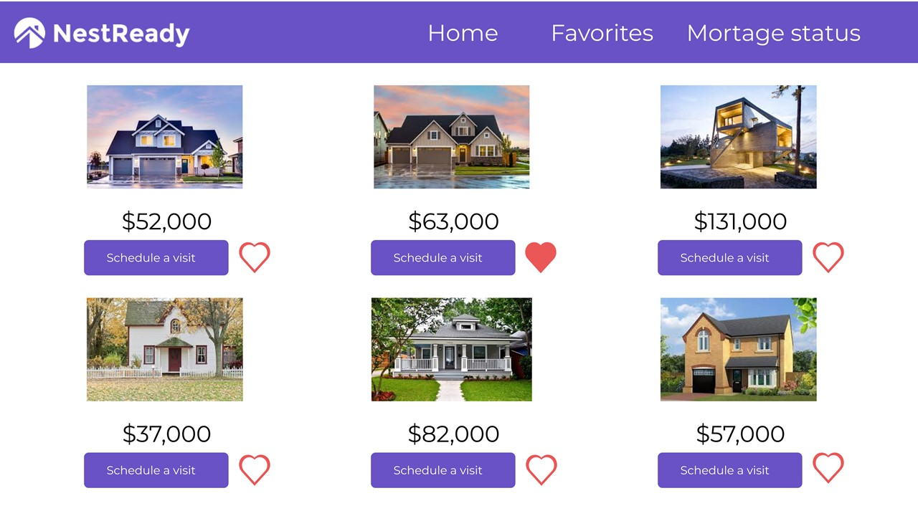
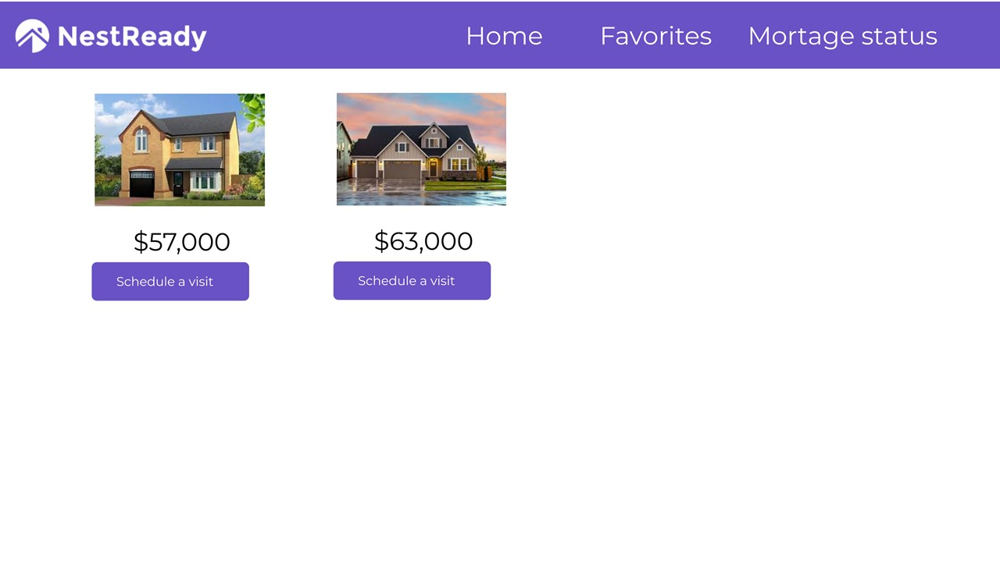
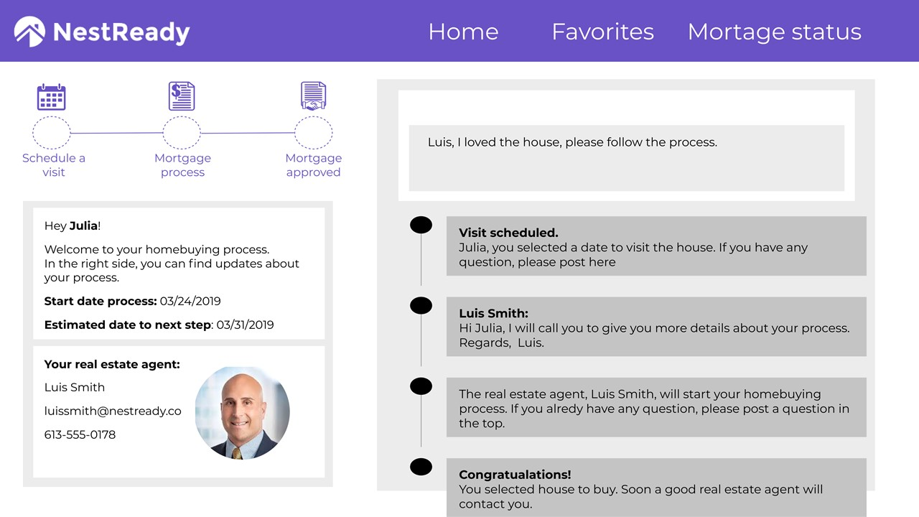
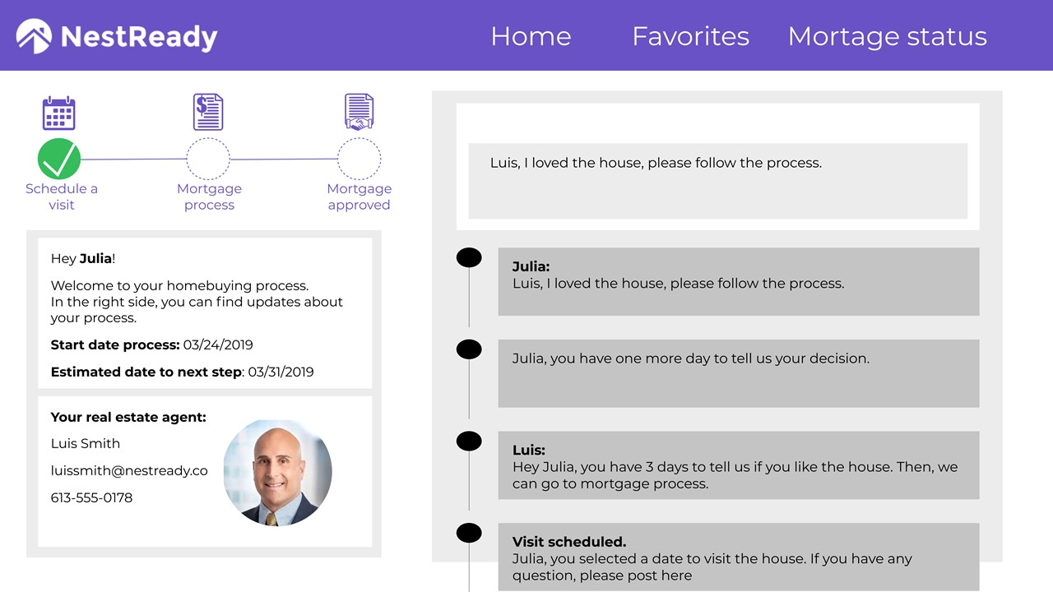
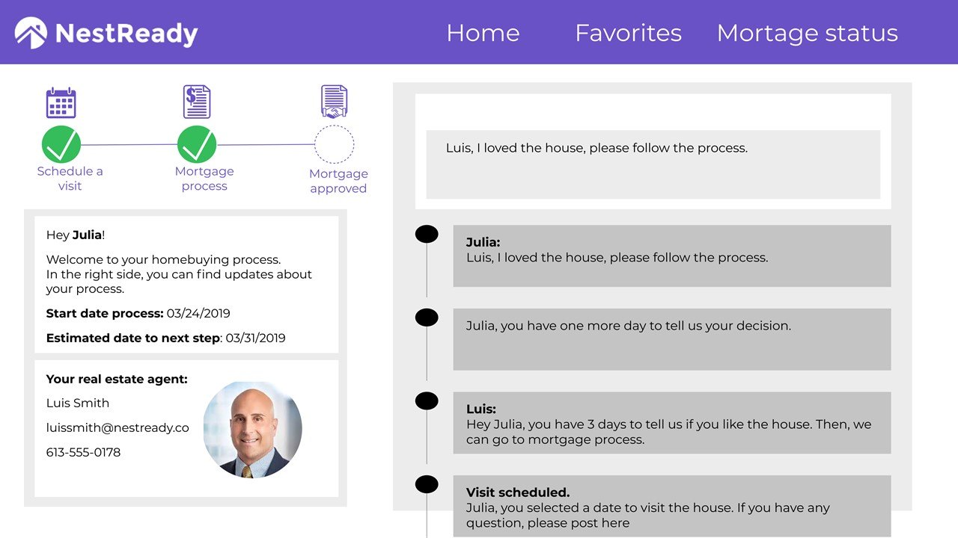
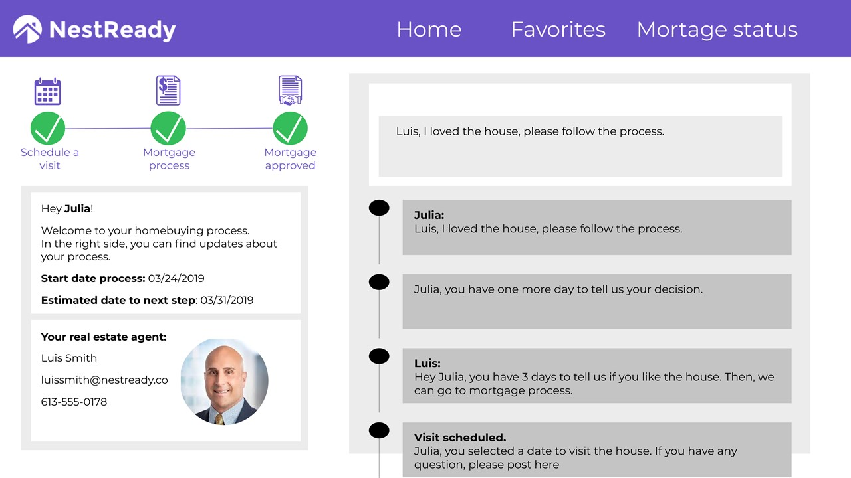

Slide 5
Frontend
Devolopment
The frontend was developed using Angular 7, NodeJS, Typescript, CSS3, HTML5, and Visual Studio Code
Frontend part:
vanhack-front.cloud.org
https://github.com/marinacrachi/vanhack-front

Slide 6
Backend
Devolopment
The backend was developed using SpringBoot, JPA, H2 database
Backend part:
vanhack-api.cloud.org
https://github.com/rssarto/real-state-seller-app

Slide 7
Devops
Devolopment
Two EC2 Instances running Red Hat Enterprise Linux, on both docker and kubernetes was installed one host acting as Master node and other one working as Worker node.
All elements from CICD pipeline is running as containerized process, building, testing and deploying the backend Application.
Both backend and frontend are running in container process managed by Kubernetes platform.
Devops Pipeline technology
Jenkins
Continous Integration Gihub
SCM SONAR
Code analysis docker
Generate container images
Kubernetes
Container managemant platform

Slide 8
Installation
Before accessing correctly the application is necessary add some information at your hosts.
If using Windows
Add at
c:\Windows\System32\Drivers\etc\hosts the following line:
18.228.150.147 vanhack-front.cloud.org api.cloud.org
If using Linux/MAC
Add at
/etc/hosts the following line
18.228.150.147 vanhack-front.cloud.org api.cloud.org

